Slide 1
Module 04 – Project
SALES PREDICTION
Nguyen Quoc Thai

Slide 2
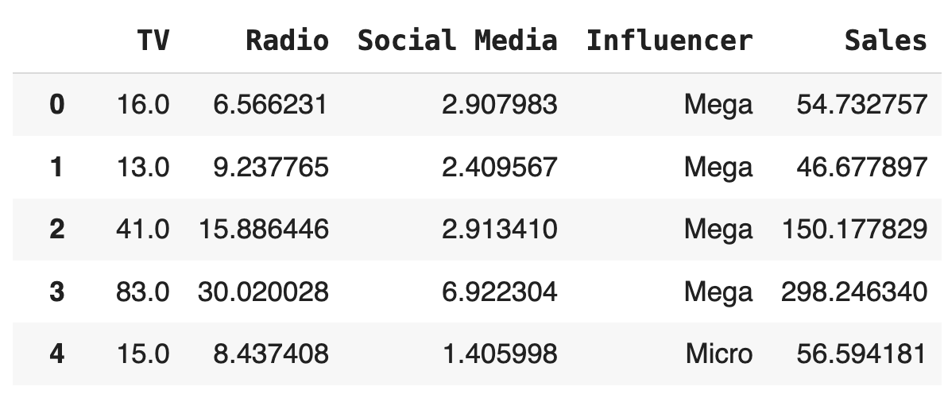
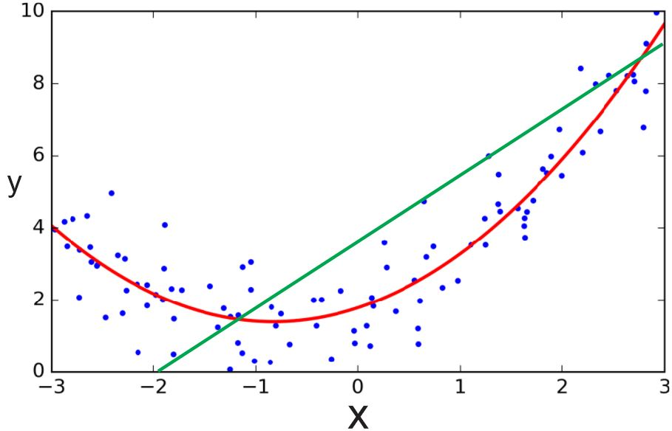
Objectives
Regression
Regression Task
Linear Regression
Non-linear Regression
Using Sklearn library
Sales Prediction
Exploratory Data Analysis (EDA)
Feature Scaling
Modeling
Evaluation
Custom Polynomial Features

Slide 3
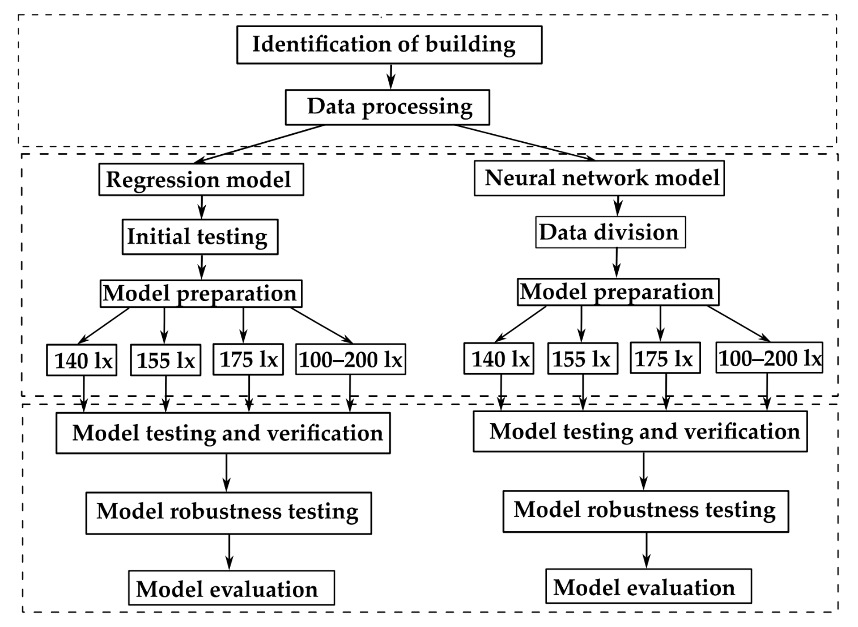
Research Ideas
!
Research ideas with polynomial regression applications
A Comparative Analysis of Polynomial Regression and Artificial Neural Networks for Prediction of Lighting Consumption
Các nhóm (Gồm các thành viên thuộc AIO) có lời giải sơ bộ, AD Vinh sẽ hướng dẫn tiếp để ra paper.

Slide 4
Outline
SECTION 1
SECTION 2
Regression
Sales Prediction
Notes:
Introduction: 45p
Application: 60p
MQA: 15p
Polars: 15p

Slide 5
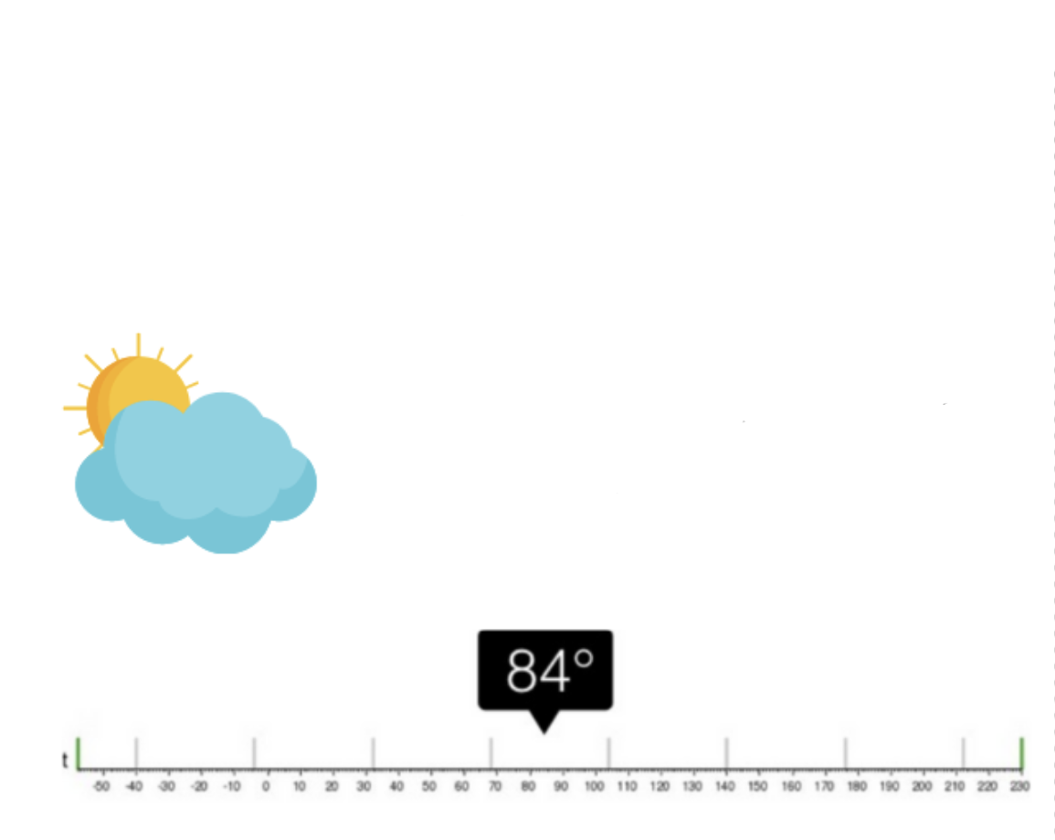
Regression
!
Regression Task
Regression
Training Data
Predict a continuous value based on the input variables
Feature
Continous Label
What will be the temperature tomorrow?
…
…
Test Data
?

Slide 6

Regression
!
Regression Task
Data
Level | Salary
0 | 8
1 | 15
2 | 18
3 | 22
4 | 26
5 | 30
6 | 38
7 | 47
Level | Salary
3,5 | ?
10 | ?
Prediction
Learning

Slide 7
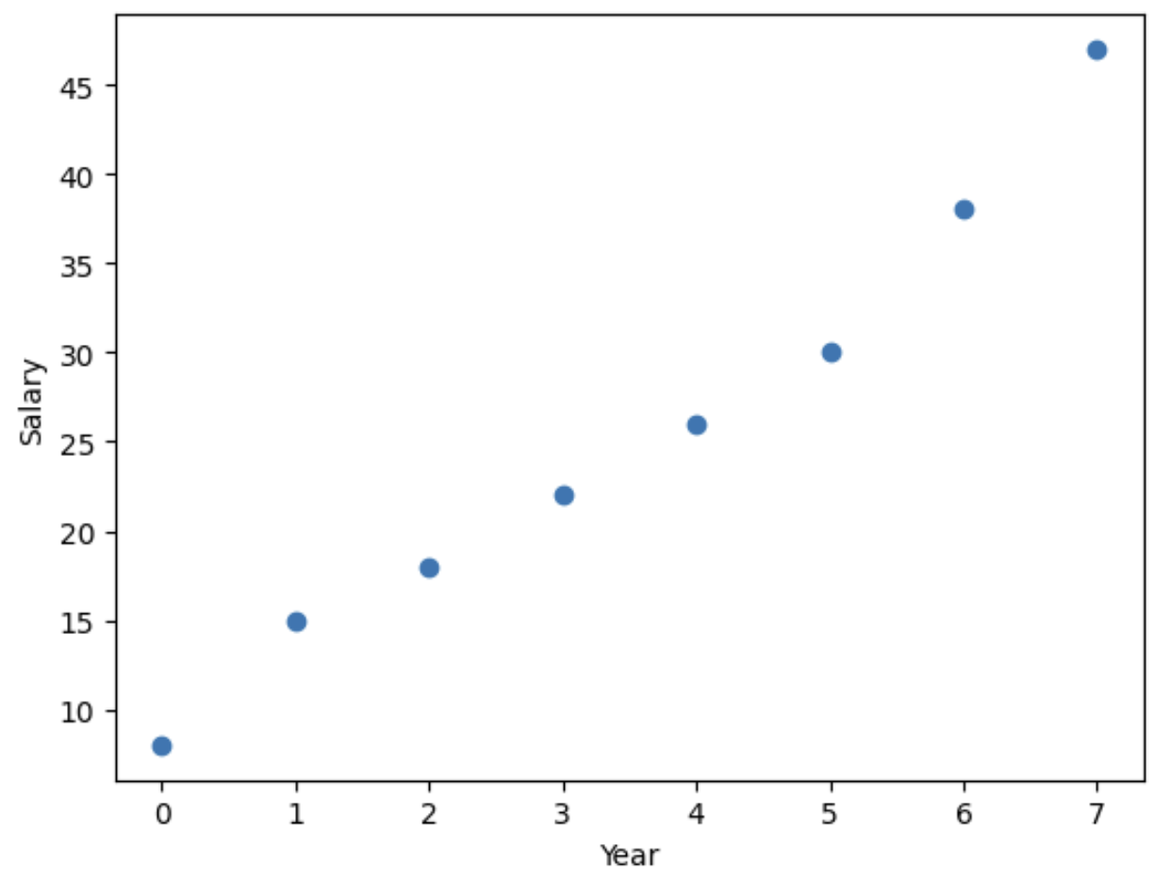
Regression
!
Linear Regression
Data
Modeling
Visualization
Level | Salary
0 | 8
1 | 15
2 | 18
3 | 22
4 | 26
5 | 30
6 | 38
7 | 47
y = wx + b
y = 6x + 7
y = f(x): linear function
Find w and b to fit the data

Slide 8
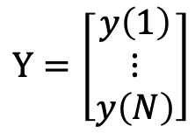
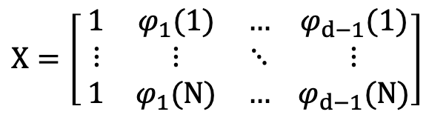
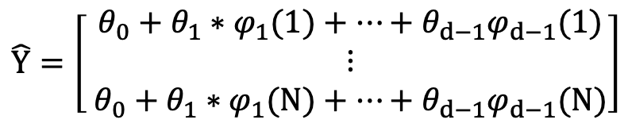
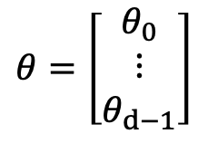
Regression
!
Linear Regression using Gradient Descent
Data
Inputs / Features
Target
Level | Salary
0 | 8
1 | 15
2 | 18
3 | 22
4 | 26
5 | 30
6 | 38
7 | 47
$$X=\left[ \begin{matrix}1 & φ_{1}(1) & … \\ ⋮ & ⋮ & ⋱ \\ 1 & φ_{1}(N) & …\end{matrix} \begin{matrix}φ_{d−1}(1) \\ ⋮ \\ φ_{d−1}(N)\end{matrix}\right]$$
$$Y=\left[\begin{matrix}y\left(1\right) \\ ⋮ \\ y\left(N\right)\end{matrix}\right]$$
Weight
Predict
$$θ=\left[\begin{matrix}θ_{0} \\ ⋮ \\ θ_{d−1}\end{matrix}\right]$$
$$\hat{Y}=\left[ \begin{matrix}θ_{0}+θ_{1}∗φ_{1}(1)+…+θ_{d−1}φ_{d−1}(1) \\ ⋮ \\ θ_{0}+θ_{1}∗φ_{1}(N)+…+θ_{d−1}φ_{d−1}(N)\end{matrix}\right]$$

Slide 9
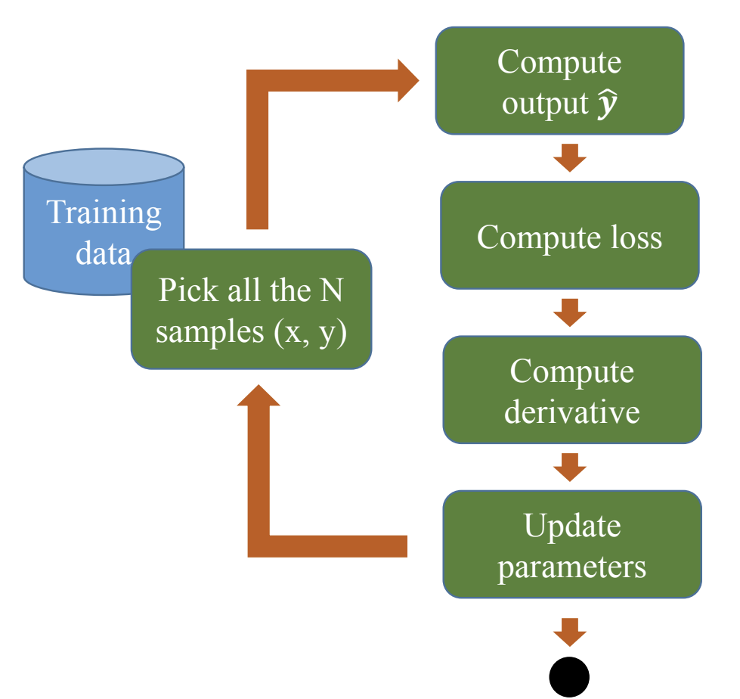
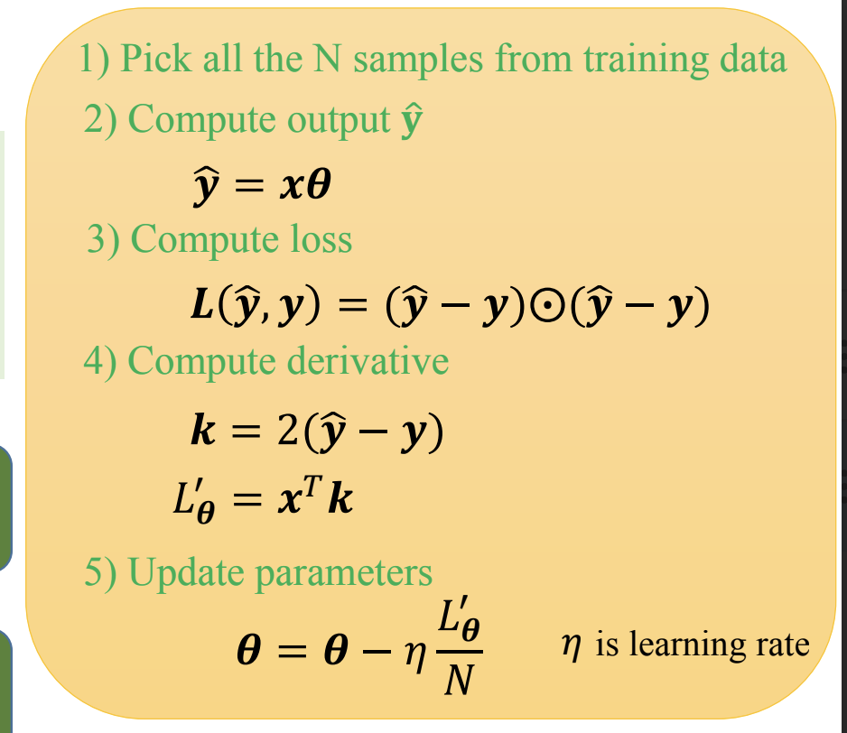

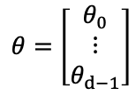
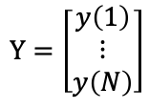
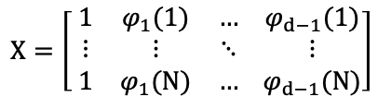
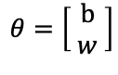
Regression
!
Linear Regression using Gradient Descent
Data
Learning
$$X=\left[ \begin{matrix}1 & φ_{1}(1) & … \\ ⋮ & ⋮ & ⋱ \\ 1 & φ_{1}(N) & …\end{matrix} \begin{matrix}φ_{d−1}(1) \\ ⋮ \\ φ_{d−1}(N)\end{matrix}\right]$$
$$Y=\left[\begin{matrix}y\left(1\right) \\ ⋮ \\ y\left(N\right)\end{matrix}\right]$$
y = wx + b
$$θ=\left[\begin{matrix}b \\ w \end{matrix}\right]$$
$$θ=\left[\begin{matrix}θ_{0} \\ ⋮ \\ θ_{d−1}\end{matrix}\right]$$

Slide 10
Regression
!
Limitation
Modeling
y = wx + b
The main disadvantage of this technique is that the model is linear in both the parameters and the features. This is a very restrictive assumption, quite of the often data exhibits behaviours that are nonlinear in the features
Extend this approach to more flexible models…

Slide 11
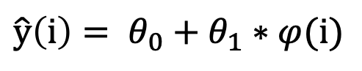
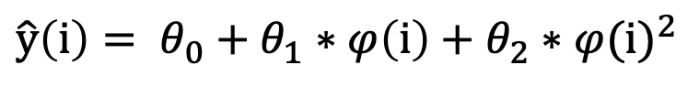
Regression
!
Moving Beyond Linearity
Data Visualization
Linear function
$$\hat{y}\left(i\right)= θ_{0}+θ_{1}∗φ(i)$$
Polynomial function
$$\hat{y}\left(i\right)= θ_{0}+θ_{1}∗φ\left(i\right)+θ_{2}∗{φ(i)}^{2}$$
Nonlinear regression estimates the ouput based on nonlinear function
Notice that the prediction is still linear in the parameters but nonlinear in the features

Slide 12
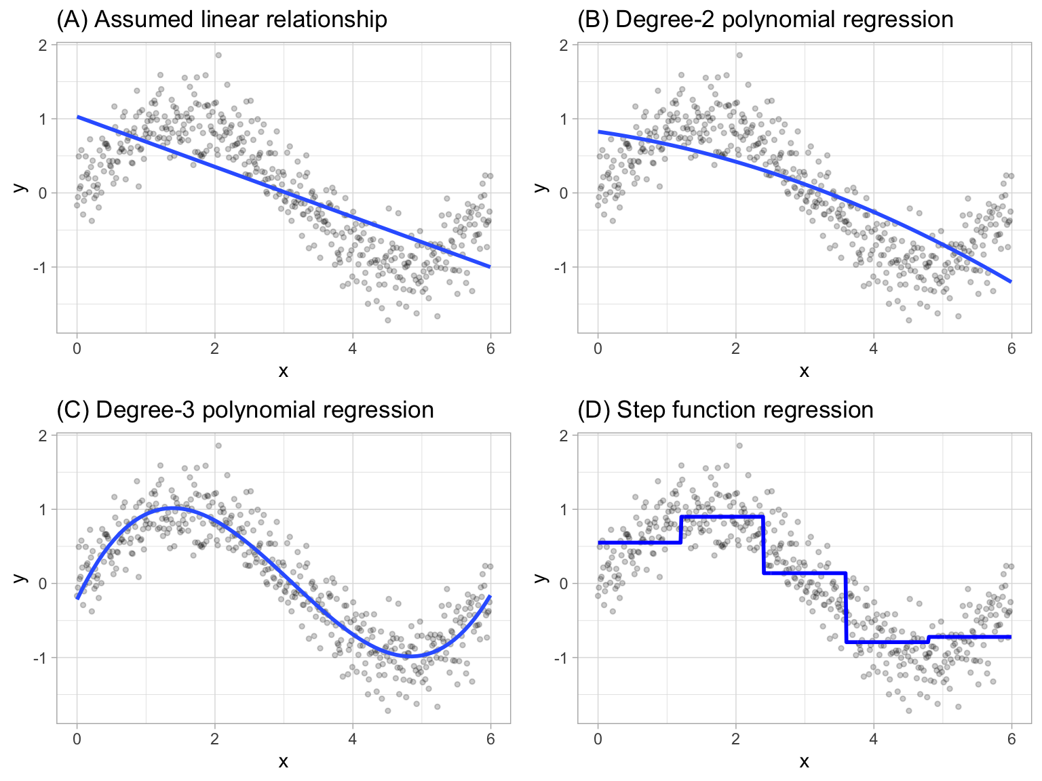
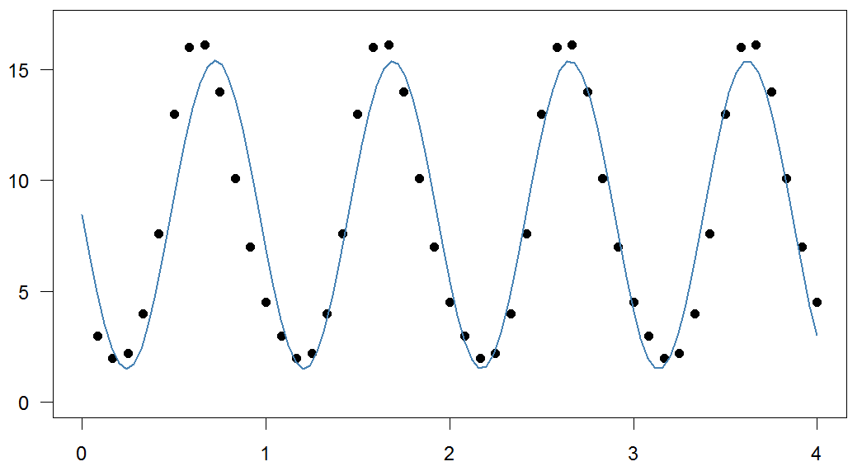
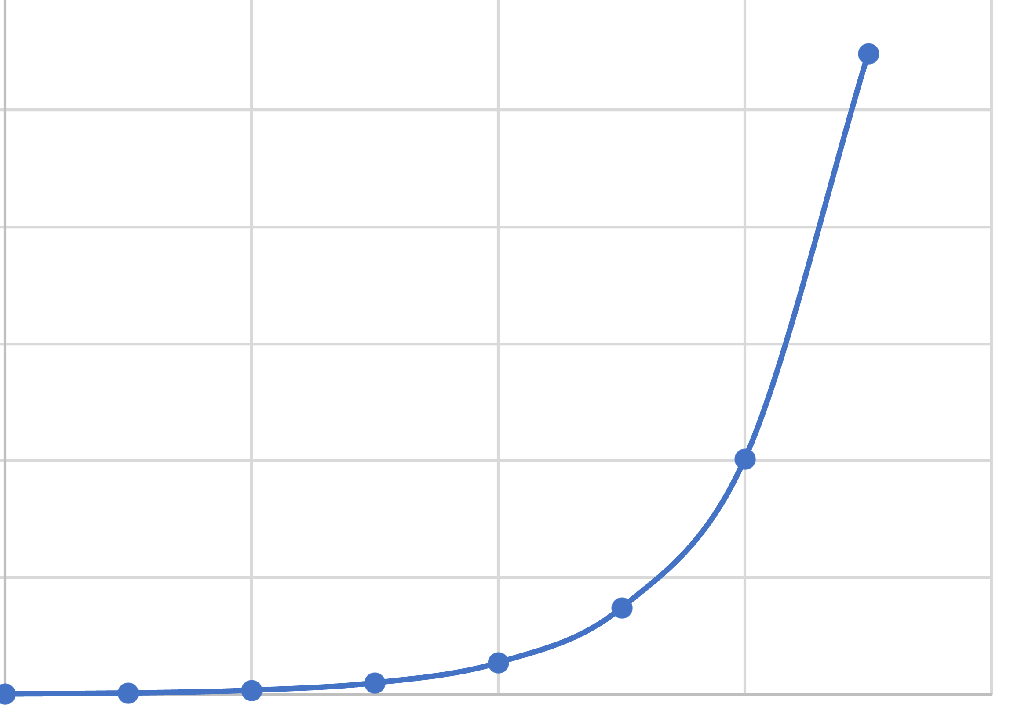
Regression
!
Moving Beyond Linearity
2-degree polynomial function
3-degree polynomial function
Step function
Sinusoidal
Exponetial function

Slide 13
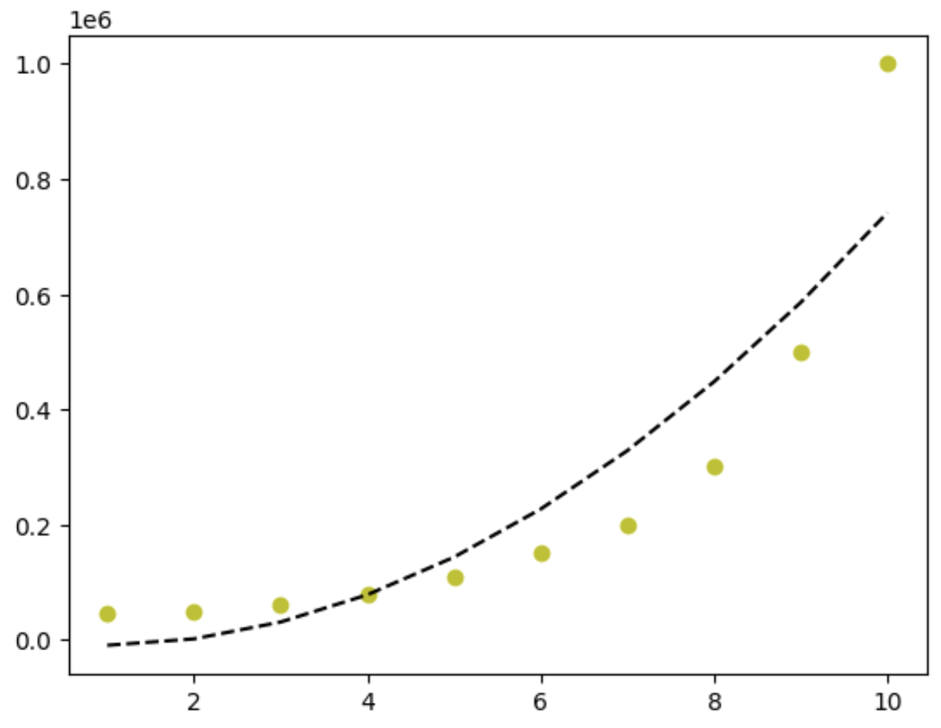
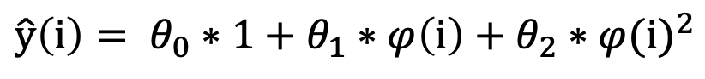

Regression
!
Polynomial Regression
2-degree polynomial function
$$\hat{y}\left(i\right)= θ_{0}∗1+θ_{1}∗φ\left(i\right)+θ_{2}∗{φ(i)}^{2}$$
Find $θ_{0}$, $θ_{1}$, $θ_{2}$to fit the data
y = 5x² + 6x + 7

Slide 14
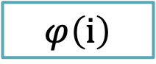
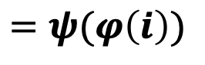

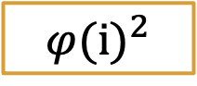
Regression
!
Polynomial Features
2-degree polynomial function
Create polynomial feature
$$\hat{y}\left(i\right)= θ_{0}∗1+θ_{1}∗φ\left(i\right)+θ_{2}∗{φ(i)}^{2}$$
$$1$$
$$φ\left(i\right)$$
$$=ψ(φ\left(i\right))$$
$${φ(i)}^{2}$$
$ψ\left(∙\right)$is referred to as basis function and it can be seen as a funtion that transforms the input in some way (In this case its powers function)

Slide 15

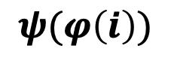

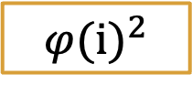
Regression
!
Polynomial Features
2-degree polynomial function
Create polynomial feature
$$\hat{y}\left(i\right)= θ_{0}∗1+θ_{1}∗φ\left(i\right)+θ_{2}∗{φ(i)}^{2}$$
Data
$$ψ(φ\left(i\right))$$
Level | Salary
0 | 45000
1 | 50000
2 | 60000
3 | 80000
4 | 110000
5 | 160000
Input
$$1$$
$$φ\left(i\right)$$
$${φ(i)}^{2}$$
0
1
2
3
4
5
1
1
1
1
1
1
0
1
2
3
4
5
0
1
4
9
16
25

Slide 16

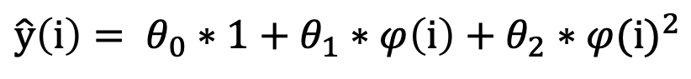

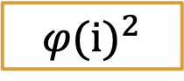
Regression
!
Polynomial Features
2-degree polynomial function
$$\hat{y}\left(i\right)= θ_{0}∗1+θ_{1}∗φ\left(i\right)+θ_{2}∗{φ(i)}^{2}$$
Features
Target
$$1$$
$$φ\left(i\right)$$
$${φ(i)}^{2}$$
1
1
1
1
1
1
0
1
2
3
4
5
0
1
4
9
16
25
45000
50000
60000
80000
110000
160000

Slide 17

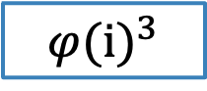

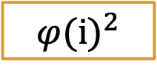
Regression
!
Polynomial Features
3-degree polynomial function
$$\hat{y}\left(i\right)= θ_{0}∗1+θ_{1}∗φ\left(i\right)+θ_{2}∗{φ\left(i\right)}^{2}+θ_{3}∗{φ(i)}^{3}$$
Features
Target
$$1$$
$$φ\left(i\right)$$
$${φ(i)}^{2}$$
$${φ(i)}^{3}$$
1
1
1
1
1
1
0
1
2
3
4
5
0
1
4
9
16
25
0
1
8
27
64
125
45000
50000
60000
80000
110000
160000

Slide 18
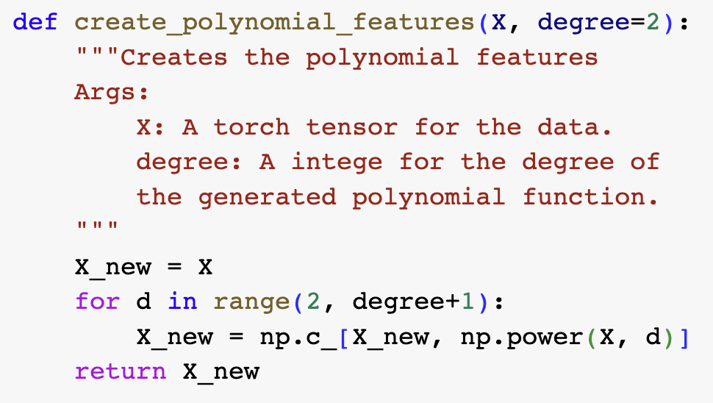
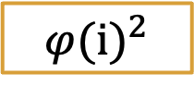
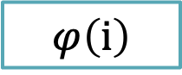

Regression
!
Polynomial Features
Input
Features
Algorithm
$$1$$
$$φ\left(i\right)$$
$${φ(i)}^{2}$$
0
1
2
3
4
5
1
1
1
1
1
1
0
1
2
3
4
5
0
1
4
9
16
25

Slide 19
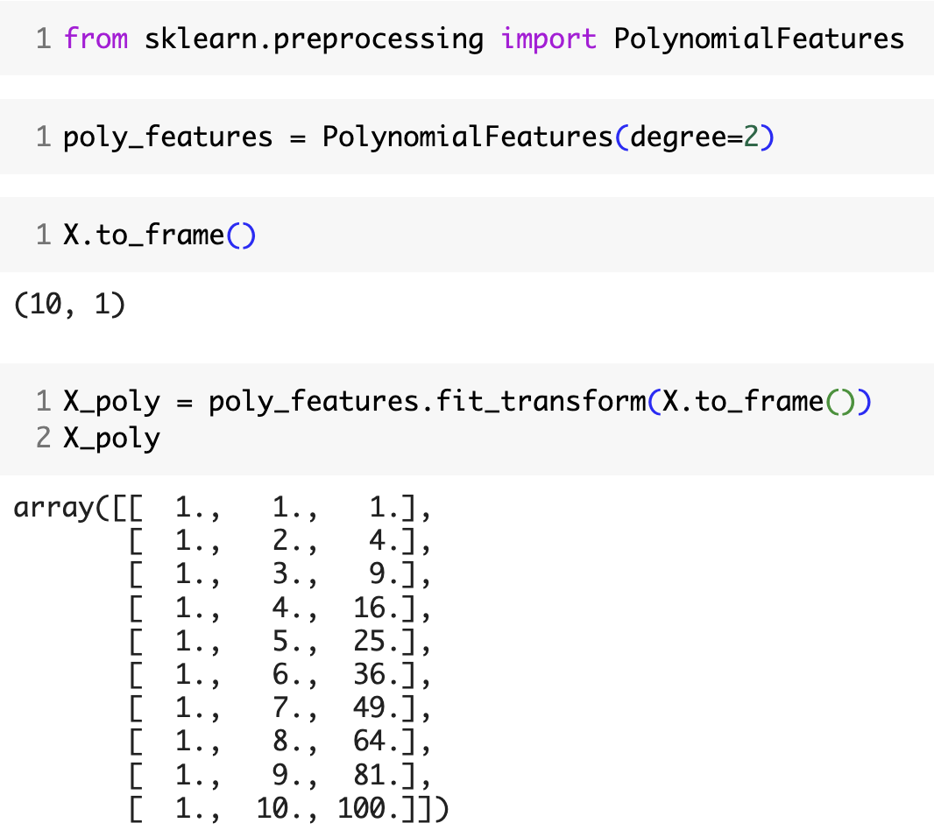
Regression
!
Polynomial Features
Input
Features
$$1$$
$$φ\left(i\right)$$
$${φ(i)}^{2}$$
0
1
2
3
4
5
1
1
1
1
1
1
0
1
2
3
4
5
0
1
4
9
16
25

Slide 20
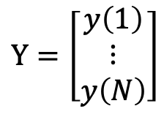
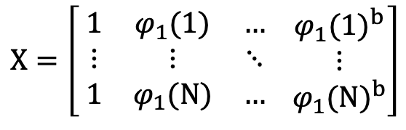
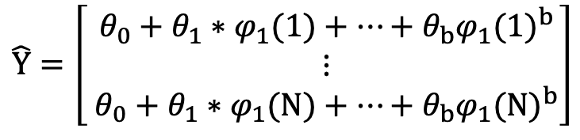
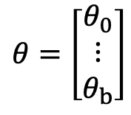
Regression
!
Vectorization
Data
Inputs / Features with b-degree
Target
$$X=\left[ \begin{matrix}1 & φ_{1}(1) & … \\ ⋮ & ⋮ & ⋱ \\ 1 & φ_{1}(N) & …\end{matrix} \begin{matrix}{φ_{1}(1)}^{b} \\ ⋮ \\ {φ_{1}(N)}^{b}\end{matrix}\right]$$
$$Y=\left[\begin{matrix}y\left(1\right) \\ ⋮ \\ y\left(N\right)\end{matrix}\right]$$
Level | Salary
0 | 45000
1 | 50000
2 | 60000
3 | 80000
4 | 110000
5 | 160000
Weight
Predict
$$θ=\left[\begin{matrix}θ_{0} \\ ⋮ \\ θ_{b}\end{matrix}\right]$$
$$\hat{Y}=\left[ \begin{matrix}θ_{0}+θ_{1}∗φ_{1}(1)+…+θ_{b}{φ_{1}(1)}^{b} \\ ⋮ \\ θ_{0}+θ_{1}∗φ_{1}(N)+…+θ_{b}{φ_{1}(N)}^{b}\end{matrix}\right]$$

Slide 21
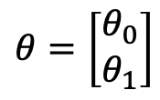
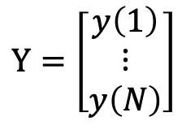
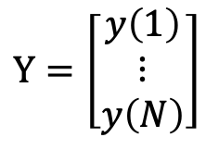
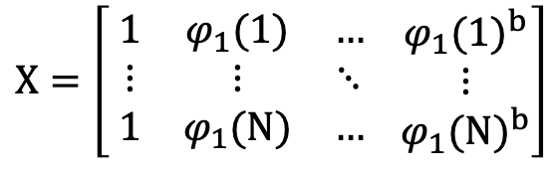
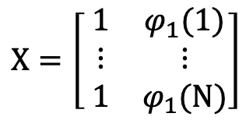

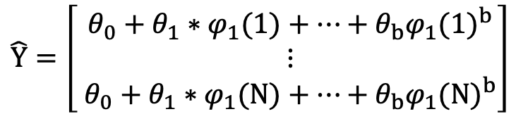
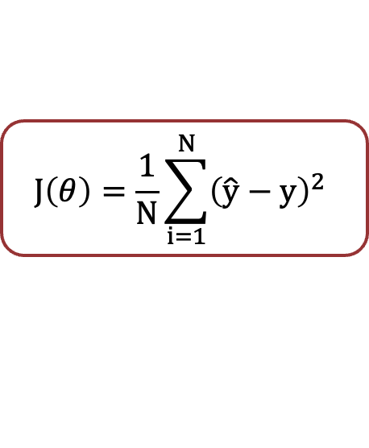
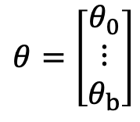
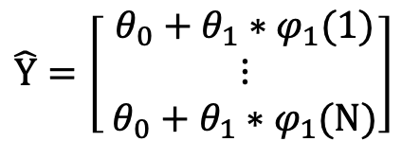
Regression
!
Model
Nonlinear Regression Model
Both models are linear in the parameters
Linear Regression Model
$$X=\left[ \begin{matrix}1 & φ_{1}(1) & … \\ ⋮ & ⋮ & ⋱ \\ 1 & φ_{1}(N) & …\end{matrix} \begin{matrix}{φ_{1}(1)}^{b} \\ ⋮ \\ {φ_{1}(N)}^{b}\end{matrix}\right]$$
$$X=\left[ \begin{matrix}1 & φ_{1}(1) \\ ⋮ & ⋮ \\ 1 & φ_{1}(N)\end{matrix}\right]$$
$$J\left(θ\right)=\frac{1}{N}\sum_{i=1}^{N}{{\left(\hat{y}−y\right)}^{2}}$$
$$Y=\left[\begin{matrix}y\left(1\right) \\ ⋮ \\ y\left(N\right)\end{matrix}\right]$$
$$θ=\left[\begin{matrix}θ_{0} \\ ⋮ \\ θ_{b}\end{matrix}\right]$$
$$Using Gradient Decent$$
$$Y=\left[\begin{matrix}y\left(1\right) \\ ⋮ \\ y\left(N\right)\end{matrix}\right]$$
$$θ=\left[\begin{matrix}θ_{0} \\ θ_{1}\end{matrix}\right]$$
$$\hat{Y}=\left[ \begin{matrix}θ_{0}+θ_{1}∗φ_{1}(1)+…+θ_{b}{φ_{1}(1)}^{b} \\ ⋮ \\ θ_{0}+θ_{1}∗φ_{1}(N)+…+θ_{b}{φ_{1}(N)}^{b}\end{matrix}\right]$$
$$\hat{Y}=\left[ \begin{matrix}θ_{0}+θ_{1}∗φ_{1}(1) \\ ⋮ \\ θ_{0}+θ_{1}∗φ_{1}(N)\end{matrix}\right]$$

Slide 22
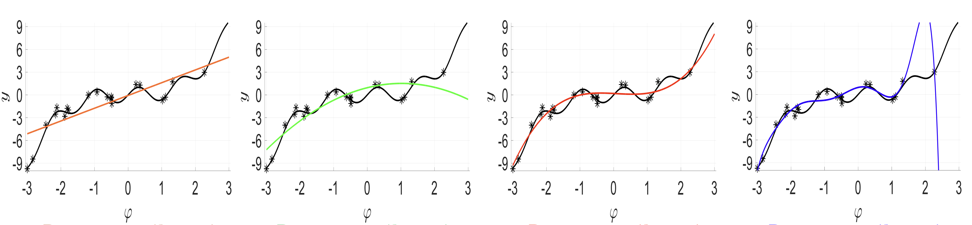
Regression
!
Degree Choice
b-degree polynomial function
$$\hat{y}\left(i\right)= θ_{0}∗1+θ_{1}∗φ\left(i\right)+θ_{2}∗{φ\left(i\right)}^{2}+…+θ_{b}∗{φ(i)}^{b}$$
The choice of the degree of the polynomial if critical and depends on the dataset at hand
1-degree
2-degree
3-degree
9-degree
Too simple/not flexible enough
Just right
Overfitting

Slide 23
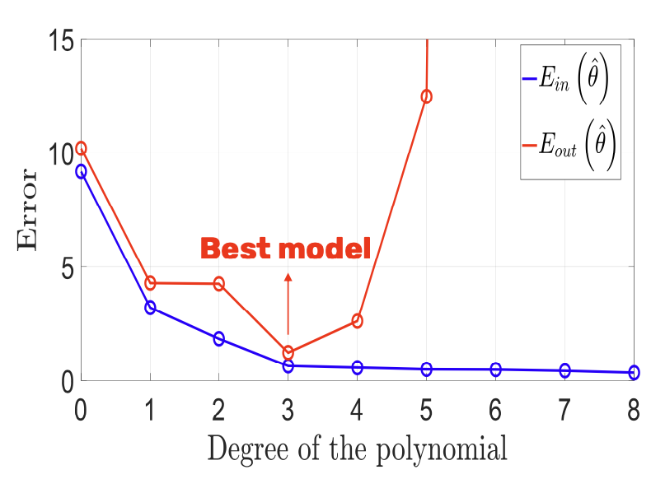
Regression
!
Degree Choice
b-degree polynomial function
$$\hat{y}\left(i\right)= θ_{0}∗1+θ_{1}∗φ\left(i\right)+θ_{2}∗{φ\left(i\right)}^{2}+…+θ_{b}∗{φ(i)}^{b}$$
The choice of the degree of the polynomial if critical and depends on the dataset at hand
Good method for choice of the degree:
K-fold cross-validation
Choose the degree which has the lowest out-of-sample error

Slide 24

Regression
!
Disadvantages
Increasing the degree of the polynomial always results in a model that is more sensitive to stochastic noise (even if that degree is the best one obtained from validation), especially at the boundaries (where we often have less data).

Slide 25


Slide 26
Outline
SECTION 1
SECTION 2
Regression
Sales Prediction
Notes:
Introduction: 45p
Application: 60p
MQA: 15p
Polars: 15p

Slide 27





Sales Prediction
!
Dataset
Dataset
Preprocessing
Feature Scaling
Modeling
Evaluation
Exploratory
Data Analysis

Slide 28

Sales Prediction
!
Dataset

Slide 29


Sales Prediction
!
Dataset

Slide 30

Sales Prediction
!
Preprocessing – One hot encoding

Slide 31



Sales Prediction
!
Preprocessing – Handling Missing Values

Slide 32


Sales Prediction
!
EDA

Slide 33


Sales Prediction
!
EDA

Slide 34

Sales Prediction
!
Train Test Split

Slide 35




Sales Prediction
!
Feature Scaling
MaxAbsScaler
$$x_{new}=\frac{x}{x_{max}}$$
MinMaxScaler
$$x_{new}=\frac{x−x_{min}}{x_{max}−x_{min}}$$
StandardScaler
$$x_{new}=\frac{x−μ}{σ}$$

Slide 36
Sales Prediction
!
Modeling

Slide 37

Sales Prediction
!
Modeling

Slide 38

Sales Prediction
!
Polynominal Regression

Slide 39

Sales Prediction
!
Polynominal Regression

Slide 40

Sales Prediction
!
Custom Polynominal Regression

Slide 41

Sales Prediction
!
Custom Polynominal Regression

Slide 42
Sales Prediction
!
Results
Model | R2
Linear Regression | 0.9821
Polynominal Regression (2) | 0.9786
Custom Polynominal Regression | 0.9821

Slide 43
Summary
Regression
Regression Task
Linear Regression
Non-linear Regression
Using Sklearn library
Sales Prediction
Exploratory Data Analysis (EDA)
Feature Scaling
Modeling
Evaluation
Custom Polynomial Features

